Slide 2
You will be able to:
Tell the history of salvation up to the Incarnation.
Explain how Jesus fulfilled some of the prophecies of the Old Testament.
Use what Jesus said about himself to demonstrate that he is God.
Identify those events and facts about Jesus’ life which reveal his full divinity, and those which reveal his full humanity.
Reflect on what it means practically and personally in your life that Jesus is Lord.

Slide 3
Write an answer in your spiritual journal:
‘How did I share my faith this week?’

Slide 4
In the fullness of time, God sent his only-begotten Son, Jesus Christ, to save us. His name means “God saves”. In him, God showed us how much he loved us by becoming one of us, by experiencing everything we experience except sin.

Slide 5
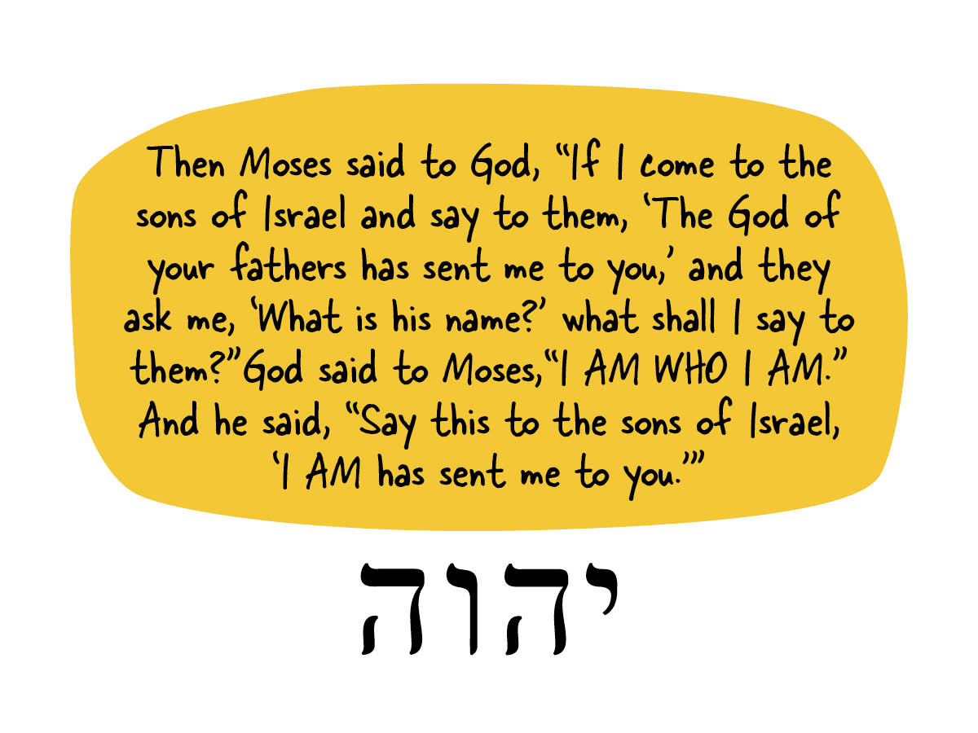

Slide 6
Do I want to give myself completely to Jesus?
How can I trust him more?
How can I give more of my life to him?

