Slide 2
You will be able to:
Recall a definition for “covenant”.
List the Ten Commandments in order.
Describe the covenants God made with Abraham and Moses.
Explain how God drew more and more people to himself, culminating in the New Covenant in Christ.
Reflect what it means practically to follow the Ten Commandments today.
Determine that God’s promises are ultimately fulfilled in Christ and the Church.
Reflect, as a member of the Church, how you can draw friends into the Church, into a living relationship with God.

Slide 3
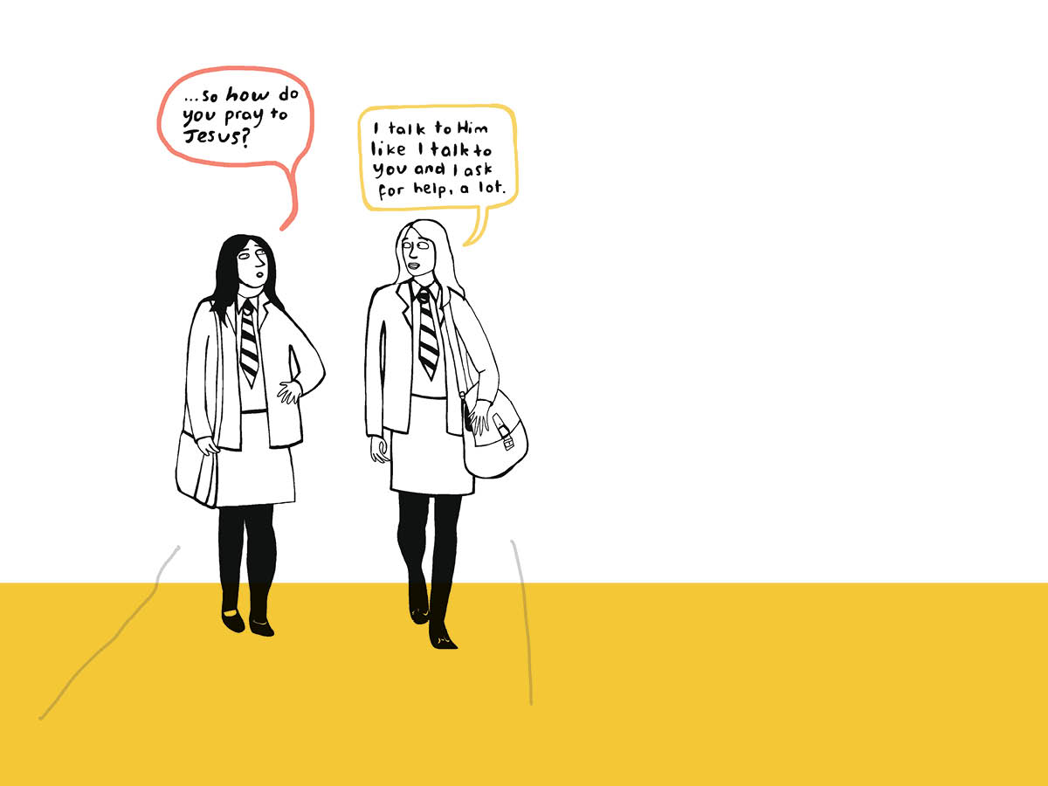
In the Old Testament, God shows himself as the one who created the world out of his love and who stays faithful to humanity, even when they fall away from him. The whole story of the Bible is the story of God the Father lovingly drawing all people back to himself.

Slide 5
I am the Lord your God: you shall not have strange Gods before me.
You shall not take the name of the Lord your God in vain.
Remember to keep holy the Lord’s day.
Honour your father and your mother.
You shall not kill.
You shall not commit adultery.
You shall not steal.
You shall not bear false witness against your neighbour.
You shall not covet your neighbour’s wife.
You shall not covet your neighbour’s goods.

