Slide 2
You will be able to:
Recall a definition for the human soul.
Explain how Christ revealed the dignity of human beings.
Examine how we can treat people as “things” rather than “persons”.
Outline some human abilities and experiences which point to the existence of the soul.
Determine some ways you can develop spiritually, not just physically, and recognise what holds you back from growing spiritually.
Examine your own life to see where you are failing to live human dignity.
Analyse the way in which our culture and society attacks human dignity.

Slide 3
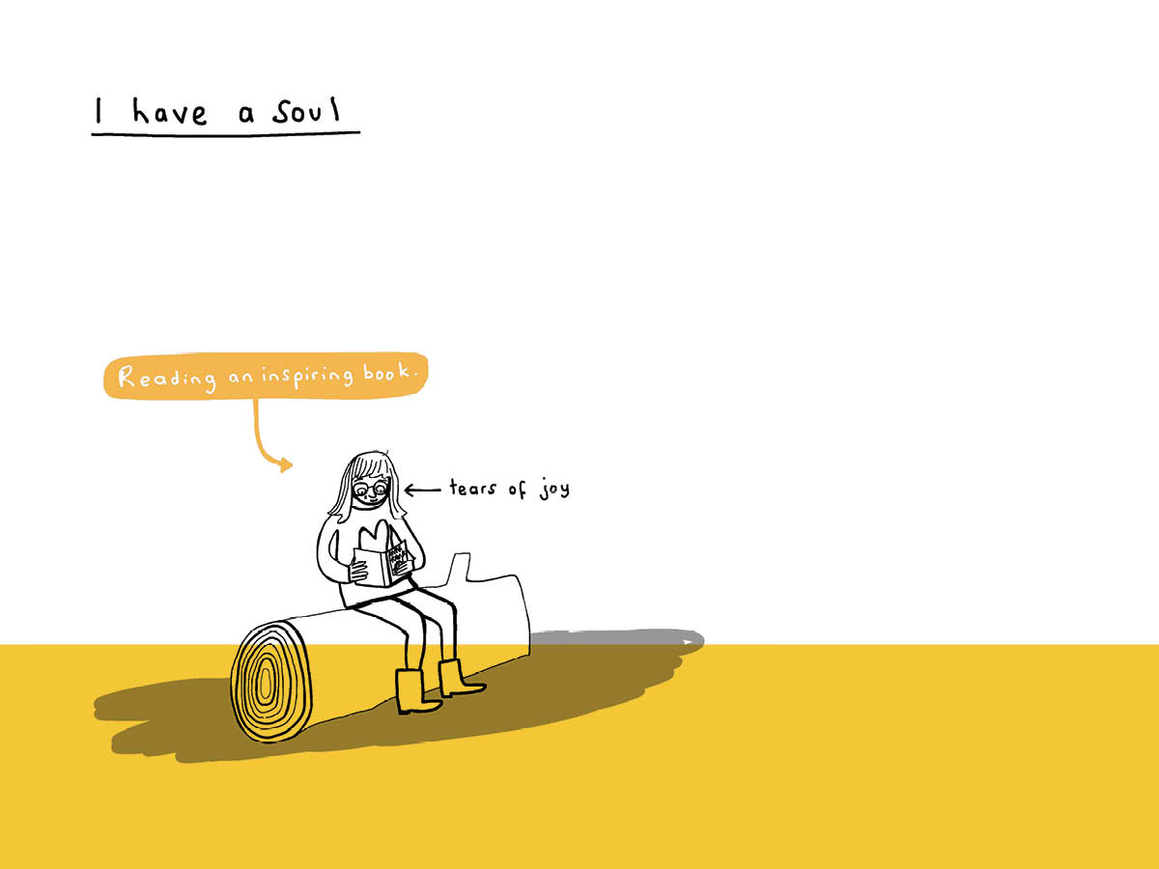
Jesus, the Son of God, is the authentic true man. In him we recognise how God willed man to be. (YouCat 60)

Slide 4
God loves us at every moment, in every “complicated” situation, even in a state of sin.
Do I realise how much God loves me?
Does the way I live reflect the dignity he has given me?

