Slide 2
You will be able to:
Recall a definition for “mystery”.
Recall a definition for “consubstantial”.
Use the words “Being” and “Person” correctly in relation to the Trinity.
Use Scripture to explain the relationship between God the Son and God the Father, and how Jesus reveals the Father.
Explain that God’s inner secret is his communion of three Persons.
Grasp that Jesus died to draw you personally into this relationship.

Slide 3
God has revealed his inner secret to us: he is not alone and solitary, he is a communion of three Persons, Father, Son and Holy Spirit. The love in the heart of God is so great, he longs to share himself with us.

Slide 4
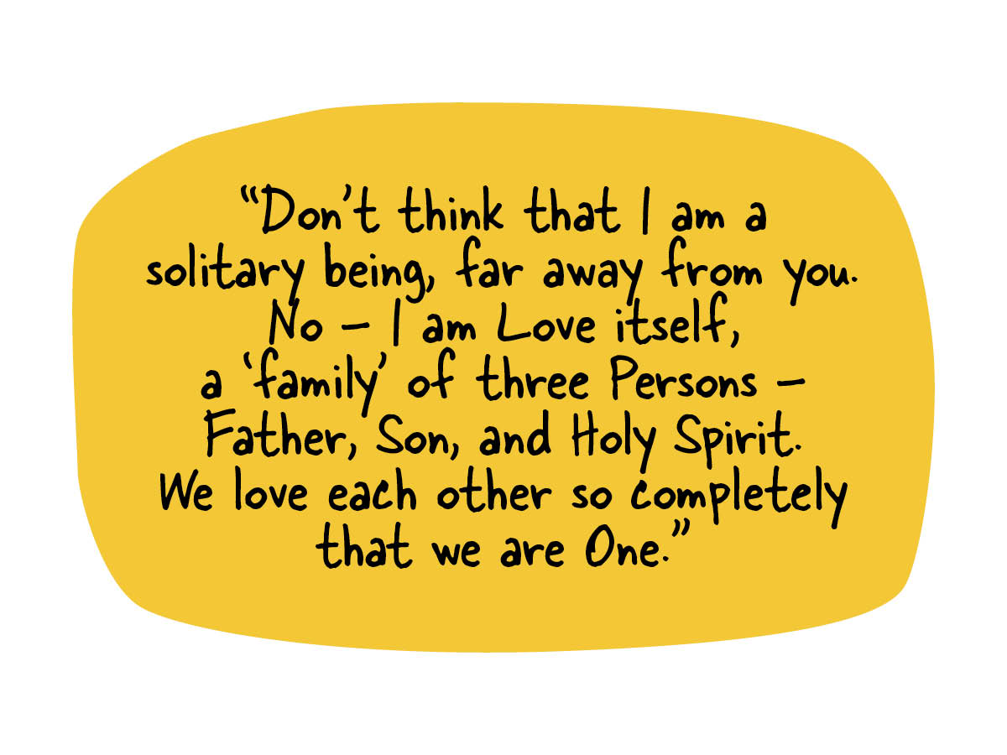

Slide 6
What do I sometimes
long for in my life?
How does it make me feel?
What amazing thing did I learn about God today?
Can he fulfil everything
I long for?

