Slide 2
You will be able to:
Recall a definition for chastity.
Recall a definition for authentic love.
Develop an awareness that your value is determined by how God sees you, rather than by mistakes you have made, by how you see yourself, or by how others see you.
Examine the different ‘ends’ of sex, and determine what makes sex ‘good’. Explain how a healthy relationship develops.
Discern how sex has a ‘language’ that expresses in a bodily way the closeness that is found only in hearts united in marriage.
Outline what is God’s plan for sex.
Put into practice some practical ways of living chastity in your own life.

Slide 3
Write an answer in your spiritual journal:
What is love?

Slide 4
God does not desire anything less for your life than a love that is strong and beautiful. He invites you through the Church to “dare to love” as Christ loved, in a way that is true, faithful, fruitful and forever.

Slide 5
“If we do not encounter love… our life is meaningless.”
Where do I experience love in my life?
How does this give my life meaning?

Slide 6
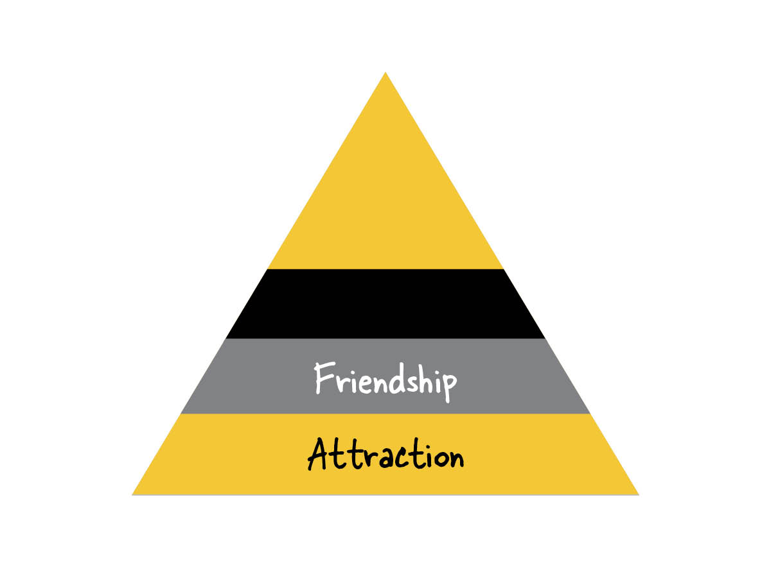
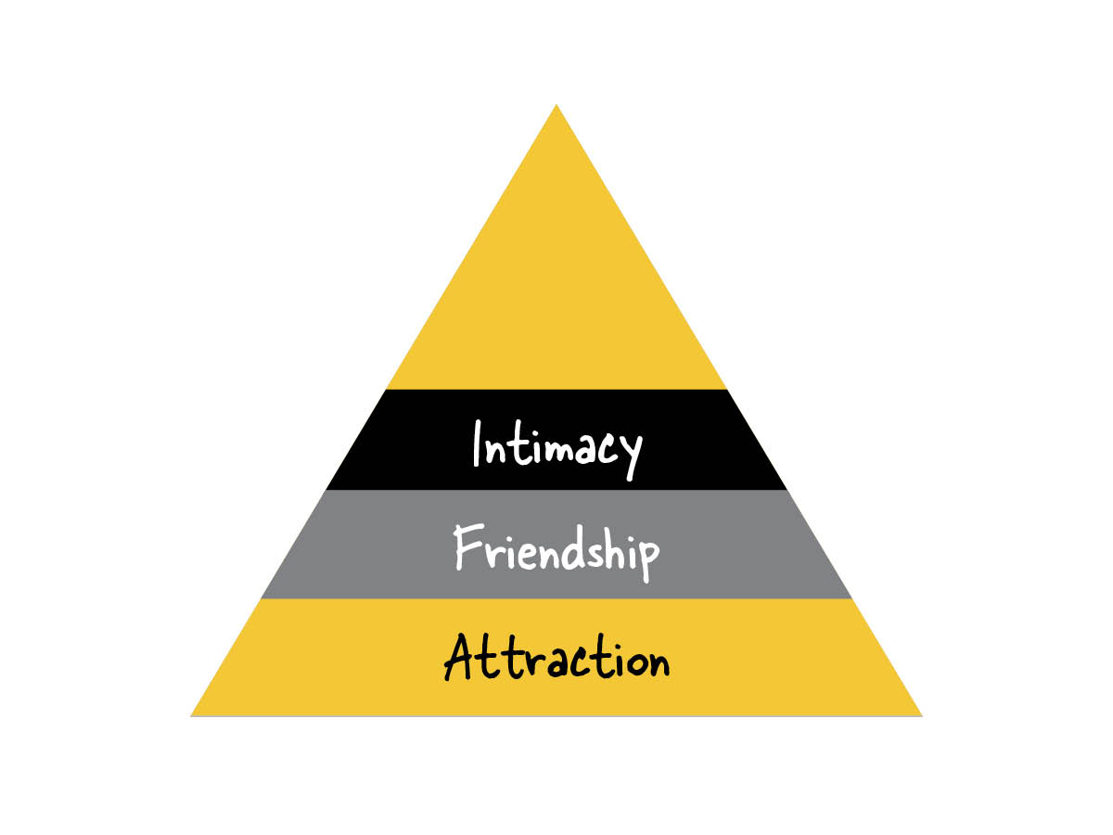
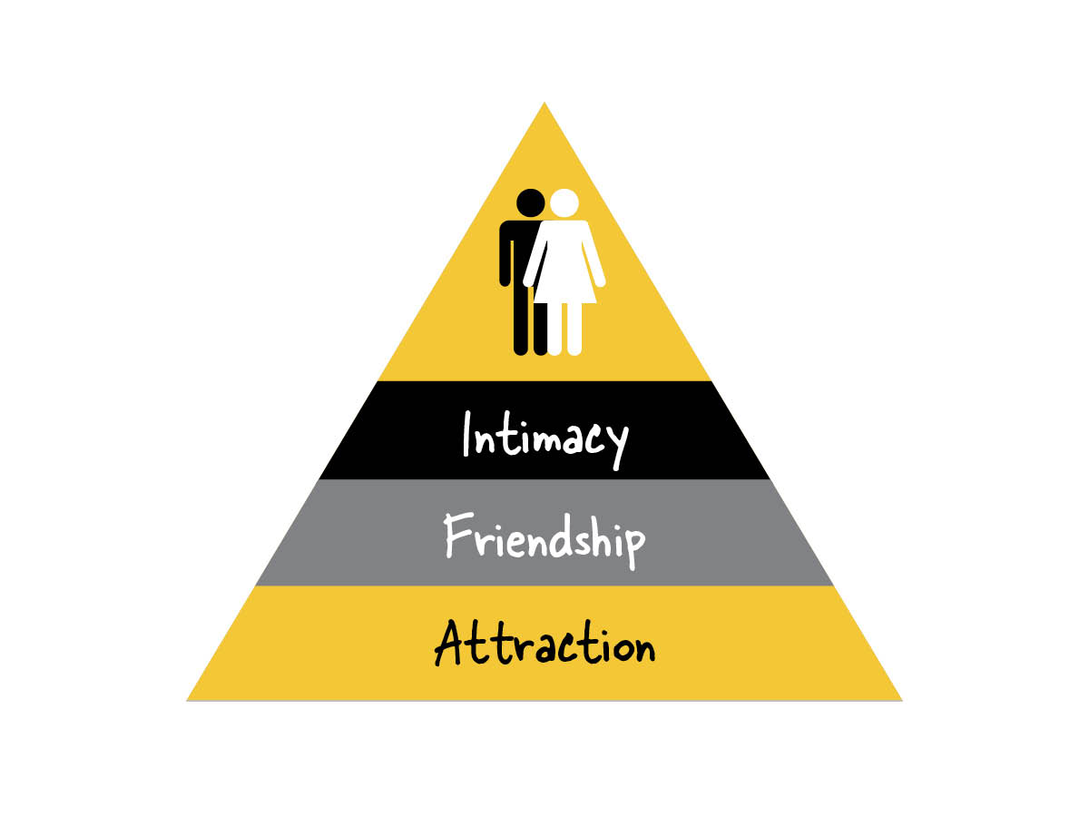

Slide 7
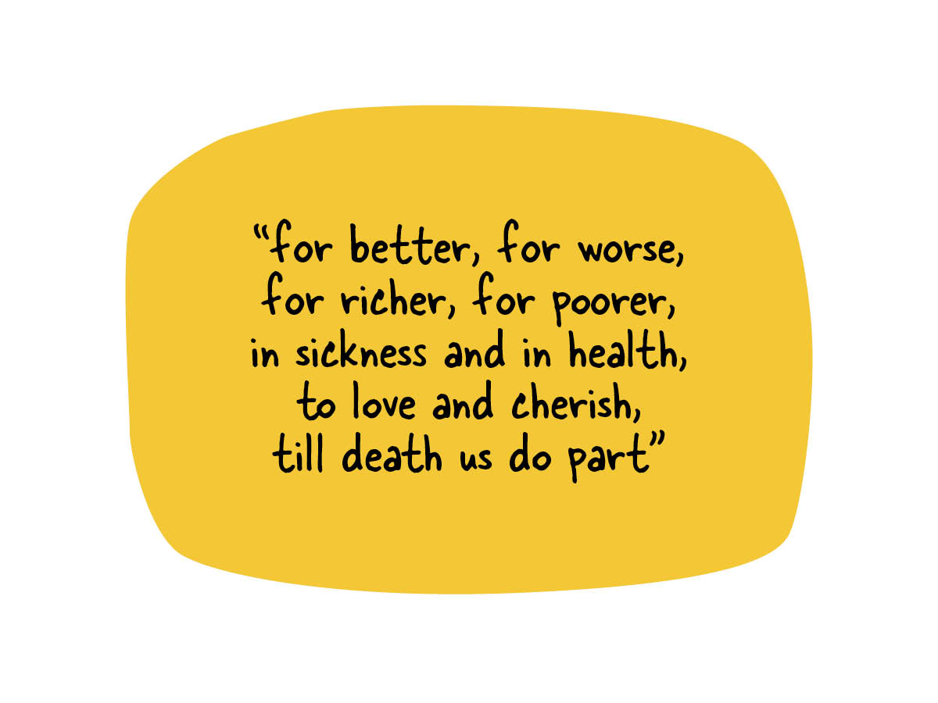

Slide 8
Make a decision about your faith and about chastity
Be aware of the pressures to be sexually active - don’t pressure
Be careful about what you watch on TV and look at on the internet. Pornography is damaging and easily becomes addictive.
Think of non-sexual ways to express your affection.
When ‘affection’ becomes ‘arousal’ it’s probably too far.
Avoid tempting situations - say goodnight in the kitchen, not the bedroom!

Slide 9
After this session, what is God saying to me about his desire for my happiness?
Is there something in my life I want to change? What do I need to ask his help for?
Is there something I need to bring to Confession?

