Slide 2
You will be able to:
List the Stations of the Cross.
Outline how the Cross is also the Tree of Life.
Outline the four reasons for Christ’s Death on the Cross.
Explain that Christ died in order to take all our sin, despair, abandonment and longing upon himself, and to give us his life.
Examine your own lives to see where you long for God.
Determine signs in the world that show how people need a Saviour.
Analyse the Eucharistic Prayer to determine that it is the same Sacrifice as the Mass.
Discover the power of the Resurrection in your own life.

Slide 3
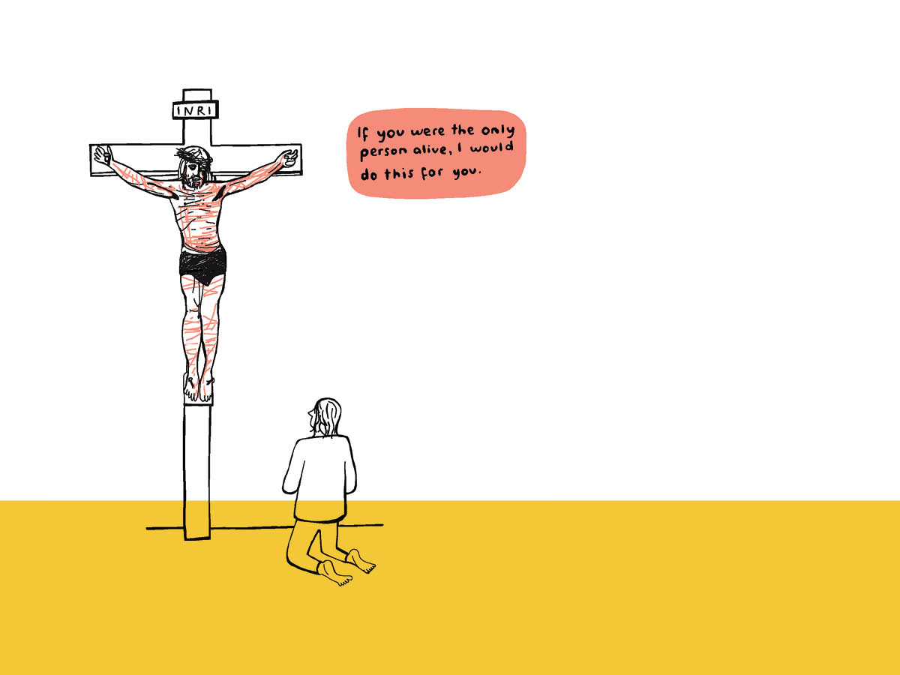
God willed to make an exchange so as to save us forever. He wanted to give us his eternal life, so that we might experience his joy, and wanted to suffer our death, our despair, our abandonment, so as to share with us in everything.

Slide 4
Thirsty for God: What do I long for in life?
What is the thing I yearn for most?
Where in my heart do I long for God?

