Slide 2
You will be able to:
Recite the Confiteor.
List the parts of the Liturgy of the Word in order.
Explain the meaning of the words “And with your spirit”.
Explain why we begin Mass with the Penitential Rite as the moment when we repent of our venial sins which will be wiped away in Holy Communion.
Explain in what ways we reverence the Gospel.
Explain that we are fed from two Tables at the Mass.
Use the method of lectio divina to pray with the Scriptures.

Slide 3
Write an answer in your spiritual journal:
‘What do I remember about the readings at Mass last Sunday?’

Slide 4
The Church draws her life and strength from Sacred Scripture. In the Liturgy of the Word, we hear God speaking directly to us, today. Jesus is everything that God would like to tell us.

Slide 5
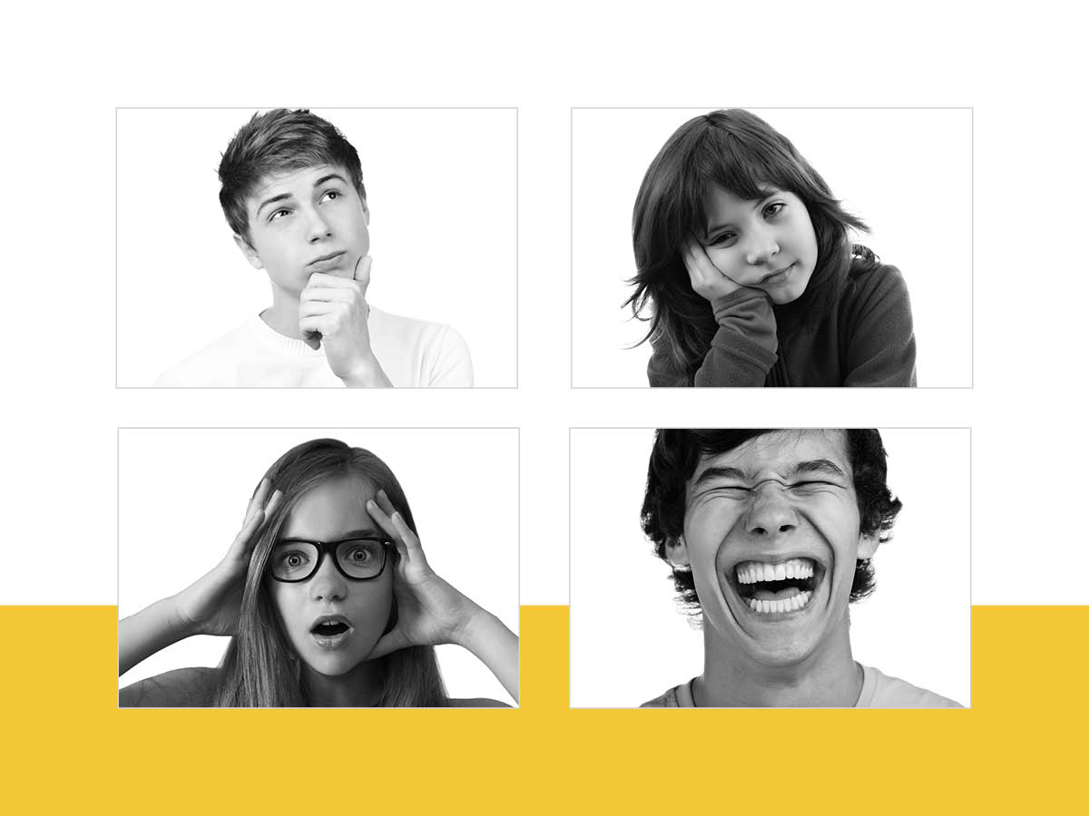

Slide 6
Sign of the Cross
Greeting
Penitential Act
Gloria
Collect (Opening Prayer)
First Reading
Psalm
Second Reading
Gospel Acclamation
Gospel
Homily
Creed
The Prayer of the Faithful

Slide 8
During Mass, how do I approach the Table of the Word?
Do I know that God wishes to feed me spiritually?
One thing I will do to receive more from God’s Word in the Liturgy of the Word is...

