Slide 2
You will be able to:
Recall a definition of “communion”.
Recall a definition of “saint”.
Outline some key teachings about Mary: how she is a Virgin; how we can call her Mother of God; that she is immaculately conceived; and how she is our Mother.
Explain the relationship between: covenant, communion, the sacraments of initiation, Mary, the Holy Spirit, and life in the Blessed Trinity.
Outline some ways in which Mary is a model for the Church.
Reflect on how God is calling you to become a saint.

Slide 3
You’re nearly there! About to be confirmed...
Which person describes best how you’re feeling about it?
Write your name beside them.

Slide 4
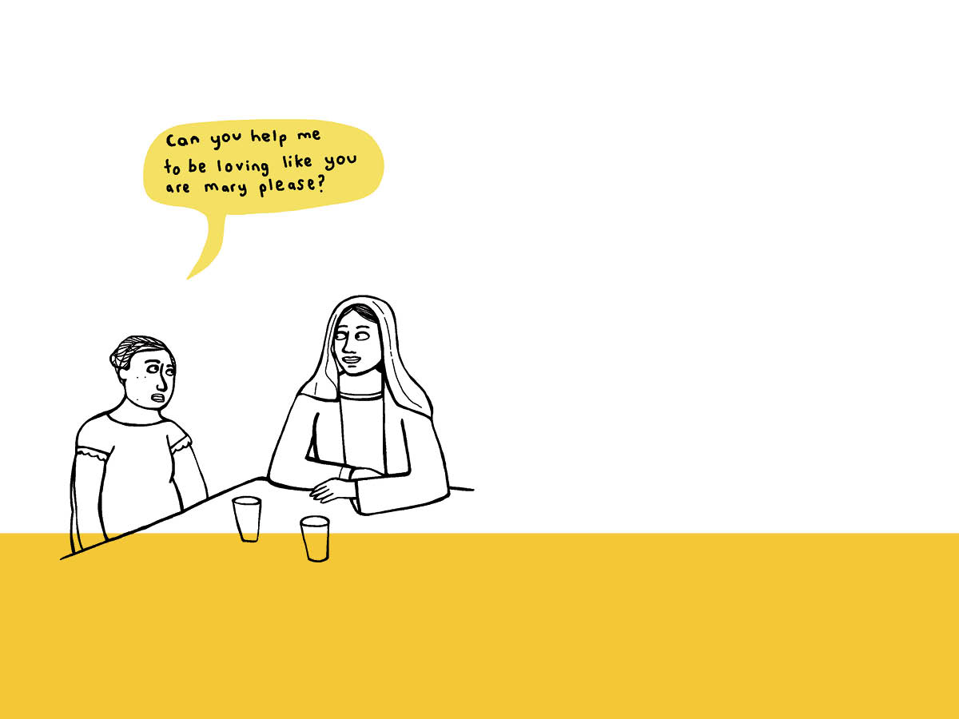
The communion of the Church doesn’t end on earth – it ends in Heaven – when the redeemed will stand face to face with God. They will be utterly blessed, beholding God forever. The communion of saints are those who have hoped in Christ, and among them, Mary the Mother of God has an especially close union with God.

Slide 5
What would I like to say most to Mary, my Mother?
What worries would I like to entrust to her?
What would I like her to pray for?

Slide 6
Now that I am about to be confirmed, how is the
Holy Spirit prompting me?
Is there anywhere in my life I am content with “second best”?
Can I open my heart wider to the Holy Spirit, and ask him to make me holy?

