Slide 2
You will be able to:
List the Four Last Things.
Distinguish between the Particular and General Judgment.
Explain that the moment of death is the end of the will’s ability to choose.
Explain the role of Purgatory in purifying the soul that dies in a state of grace.
Outline what we understand by the Resurrection of the Body.
Relate what Jesus accomplished on the Cross to the personal events of your own life.
Make a link between your own particular judgment at death, and the sacrament of Confession.
Analyse quotations from the Saints to discover what they teach us about death.
Make a decision to live fully in the light of Christ.

Slide 3
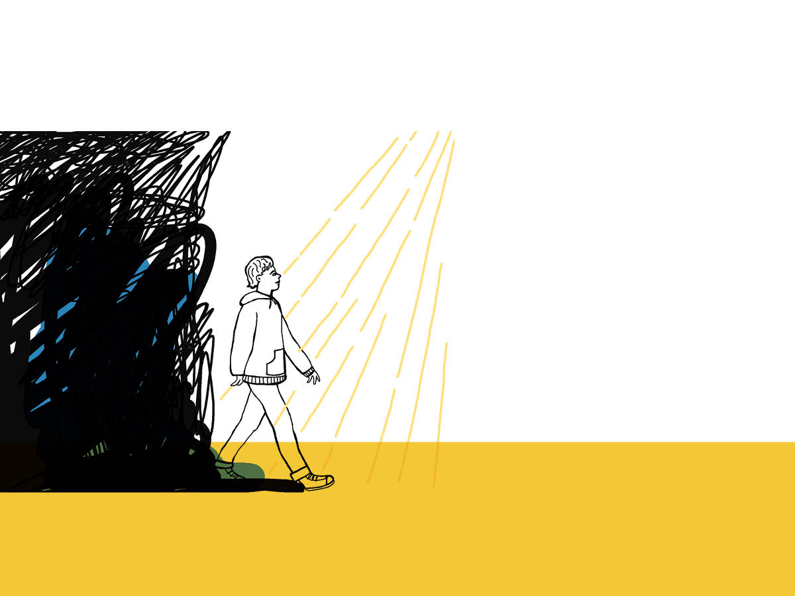
God created us to share his endless joy. He calls us to Heaven, the endless moment of love.
In Heaven, nothing more will separate us from God, whom our soul loves and has sought our whole life long.

Slide 4
Unscramble the words:
HEDTA
GNUJETDM
VEHNAE
LELH

Slide 5
At the end of time, Jesus’ glory will shine on us and nothing will be hidden. Our thoughts, deeds, relationship with God and with others will come plainly to light.
Is there anything that I hide from God which I want to bring into his light?

