Slide 1
Find the
sacraments…

Slide 2
You will be able to:
Recall a definition for “the Church”. Recall a definition for “Magisterium”.
Identify the three states of the Church – in Heaven, in Purgatory, on earth.
Explain that the power and authority of Christ was handed to the Apostles and from them down the line of bishops in what is called the “apostolic succession”.
Explain why we need to belong to the Church. Outline in what ways the Church is both divine and human.
Explain what it means for the Pope to teach infallibly.

Slide 3
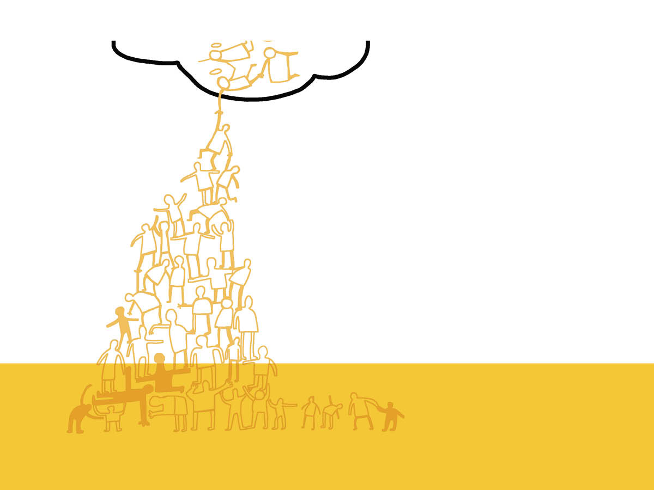
We are not called to Heaven by ourselves. God himself is not a solitary being, which is why from the beginning of time, he planned the Church, the body – the communion of peoples with God and with each other – through which his salvation would reach the ends of the earth. In the Church, we receive God’s own life even now, the beginning of our eternal life.

Slide 5
What is the definition of “the Church”?
How do the Twelve Apostles fulfil the Old Testament?
Christ and the Church are completely united: True or False?
Name the three ‘states’ of the Church.
Is the Church human or divine?

Slide 6
How does it make me feel that God has “called me forth”?
Do I want to be a disciple of Christ and a full member of the Church?
Is there a specific vocation I think God might be calling me to in my life?

Slide 7
Recall...
Write a definition for one of the following three words:
Church
Magisterium
Infallible

