Slide 2
You will be able to:
Describe the events of the Passover.
Recall the meanings of “Institution of the Eucharist” and “Epiclesis”.
Use the term “matter” to refer to the bread and wine. Use the term “form” to refer to the words of institution.
Outline what Jesus did at the Last Supper and what he commanded the Apostles to do.
Explain what is needed for the sacrifice of the Mass to take place.
Explain what is required for us to receive the Eucharist.
Analyse the story of the Passover and the Last Supper to determine that Jesus is the Paschal Lamb, the New Covenant.
Analyse the events of the Passover to see how they are fulfilled in the Mass.

Slide 3
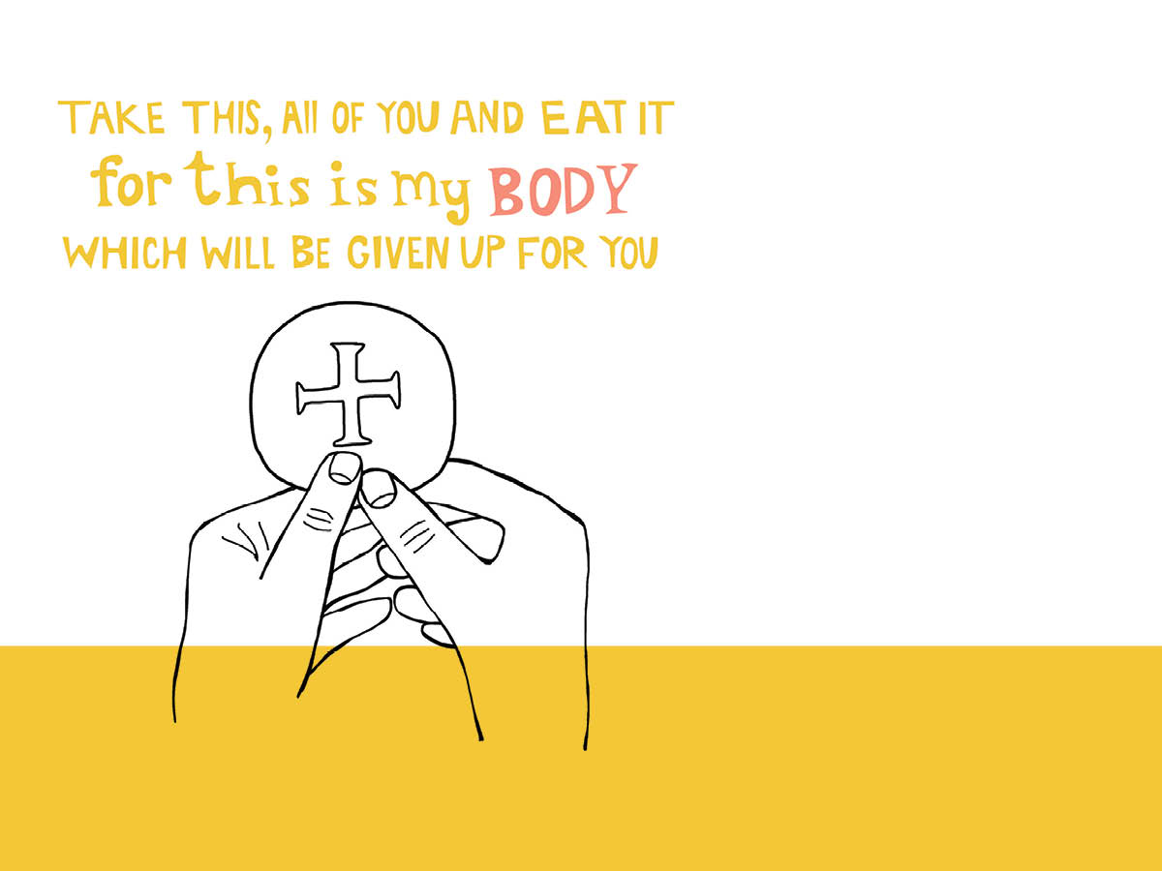
Jesus chose the Passover feast of his people Israel as the time for his death and Resurrection – it was a symbol for what was to happen. As the people Israel were freed from slavery to Egypt, so Christ frees us from the slavery of sin and death.

Slide 5
Jesus, how aware am I of your Presence in the Blessed Sacrament?
Do I show you my love and devotion in the Eucharist?
Have I ever shown a lack of reverence to you in the Eucharist?

